Slide 1
Visualization for Presentation and better Understanding!
By: Iman Khani Jazani
AI and Data Specialist, Business Developer | AiHum
Adjunct Professor | Sharif University of Technology
Senior Data Scientist, Community builder | Adin

Slide 2
Last Lecture
What is scope?
Module
Library
Package
Let’s do it with unit test!
Application of Programming in the Digital Age

Slide 3
Today
Short Presentations
Review the last lecture
Data story telling
Visualization in Python!
Application of Programming in the Digital Age!

Slide 4
Together
Send your feedback about the class whenever you want!

Slide 5

Contact me
Gmail: ImanKhaniJazani@gmail.com
LinkedIn: https://www.linkedin.com/in/ImanKhaniJazani/
Telegram: @IKJ1992

Slide 6
Short Presentations

Slide 7
Review the Last Lecture

Slide 8
Scope Level
Package
Library
Module
Class
Function
Body
S

Slide 9
Version Control in VSCode
Git
Initial explanation about:
Branch
Unchanged
Changed
Merge
Modified
Commit
Sync with GitHub

Slide 10
Data Story Telling

Slide 11
What is Data? Where is Data?
input
processing
output
Data refers to a collection of numbers, fact, figures, statistics, or any other information for analyzing and insight extraction!

Slide 12
Different problem, different data!
You can encounter with different types of data in input, output, or even in process (auxiliary)
Tabular
Numerical
Audio
Text
Image
Video
List of items
…

Slide 13
What is data story telling (DST)?
DST is a powerful technique for communicating insights from data a way that is engaging and memorable.

Slide 14
DST Procedure
Feed data
Clean data
EDA
Make questions
Extract insights
Visualize insights

Slide 15
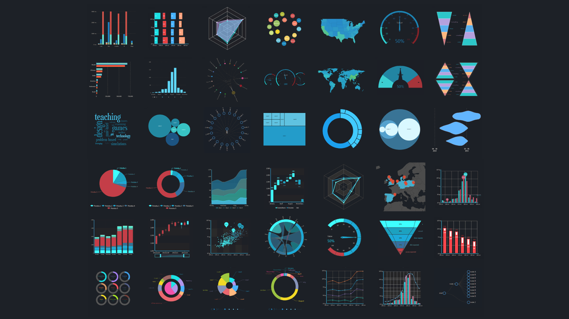
Different Charts!

Slide 16
Visualization with Python

Slide 17
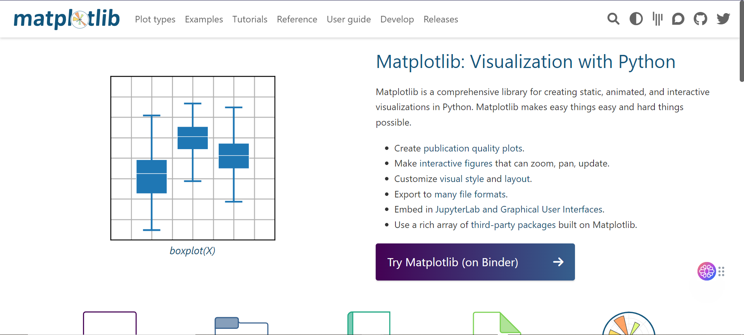
Let’s go to matplotlib.org!

Slide 18
Application of Programming in the Digital Age!

Slide 19
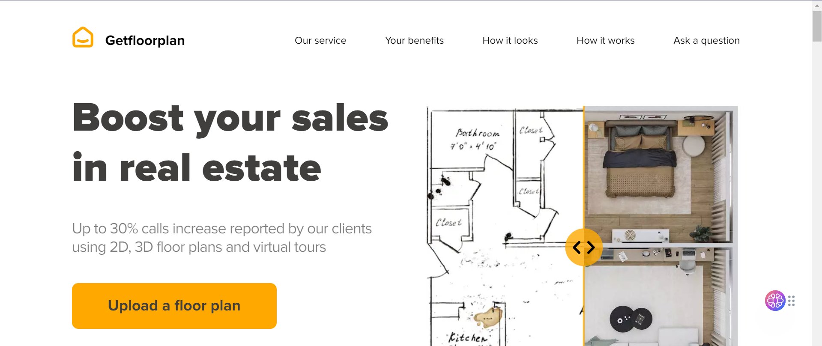
Getfloorplan
Notes:
https://unity.com/

Slide 20
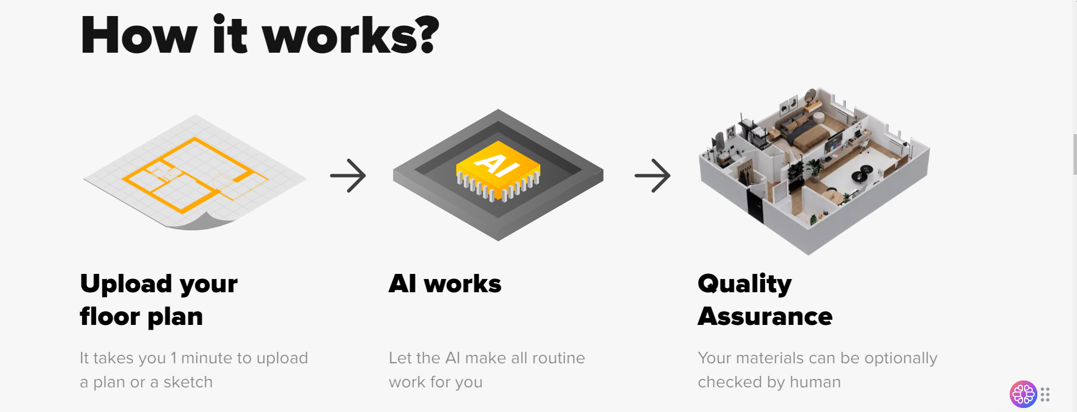
Getfloorplan

Slide 21
Lecture Resources
https://www.w3schools.com/python/matplotlib_pyplot.asp
https://www.geeksforgeeks.org/data-visualization-using-matplotlib/

